Slide 1

Building Quantum workflows using composable software within the Qiskit patterns framework
Bryce Fuller
Mariana Bernagozzi
Jessie Yu
Jennifer Glick
IEEE Quantum Week 2024
Notes:
Abstract: Delivering useful quantum computing requires turning key capabilities into software and effectively stitching them together to explore problems at scales that are hard classically. In this tutorial, we will introduce Qiskit Patterns as a framework for breaking down utility-scale quantum workloads and contextualizing the necessary capabilities into four main steps – mapping domain-specific problems to quantum circuits and operators, optimizing the circuits for the target quantum hardware, executing, and post-processing the results. We will discuss the need for developing software building blocks that address tasks within these steps and that can be composed together to build larger workflows. Then, we will highlight several software building blocks that address these steps, examples of which may include building quantum circuits with the Qiskit circuit library, transpiling circuits through the latest AI and heuristic methods, executing on quantum hardware via the Qiskit Runtime Primitives, applying error mitigation techniques such as TREX, ZNE, and PEC, and using circuit knitting techniques to further optimize circuits for execution. Participants will be introduced to the main concepts behind each of these building blocks, and will be shown how to access and configure them in Qiskit. Finally, we will show through concrete examples how such building blocks can be composed together to construct larger workflows.

Slide 2
Tutorial Agenda
First Half
Part 1—Qiskit: foundational tools for building quantum algorithms
Example: Hamiltonian simulation workflow with Qiskit (circuit library, transpiler, primitives)
Part 2—Qiskit addons: research capabilities to enable new algorithm design
Example: Hamiltonian simulation augmented with Qiskit addons (OBP and MPF)
Second Half
Part 3—Qiskit addons: large-scale eigenvalue estimation
Example: Molecular ground state estimation with Sample-based Quantum Diagonalization (SQD)

Slide 3
Part 1 Building quantum algorithms with Qiskit

Slide 4
The anatomy of a quantum algorithm
with classical inputs and outputs
Map problem instance to quantum circuits and operators
Optimize for target hardware execution
Execute via Qiskit Runtime
Result processing
Map
Optimize
Execute
Post-process
Notes:
Quantum applications are comprised of classical inputs and outputs to a reusable code block that encapsulates the quantum execution code
Quantum code follows a well-defined software pattern built from reusable building-blocks with Qiskit at the core, e.g. a service for transpiling quantum circuits
Allows for abstraction away from quantum circuits and hardware details
All q algorithms follow this basic pattern (paradigm for thinking about algorithms): mapping part, optimization, … etc. no matter what algorithm
Our SDK already provides building blocks

Slide 5
Qiskit SDK sets the foundation
Qiskit SDK gives us a base layer of building blocks for building and running quantum algorithms
Qiskit Circuit Library
Transpiler
Primitives
Quantum Info
Output: circuits + operators
Input: circuits + operators
Input: ISA circuits + operators
Input: Expectation value/samples
Output: ISA circuits + operators
Output: Expectation value/samples
Map
Optimize
Execute
Post-process
Notes:
Right now we have Qiskit library…etc.
For example, here’s how we can use elements of the Qiskit SDK into this general framework. As you can tell, we’re defining a clear set of inputs and outputs across each step.
In this case:
The Circuit Library helps me encode a mathematical expression of a problem into circuits and observables.
Then we pass these circuits and observables into the transpile to find the most efficient circuits for a target hardware, or what we’re calling ISA circuits (more on this in the next slide)…ready to execute as efficiently as possible
We have Primitives that focus on running these circuits as efficiently as possible, and perform relevant mitigation methods along the way
Qiskit helps us lay out the base building blocks needed for this a workflow…
How do we build upon the performant foundation of Qiskit to accelerate quantum algorithms research for utility?

Slide 6
1 Map 2 Optimize 3 Execute 4 Post-process
Qiskit Circuit Library

Slide 7
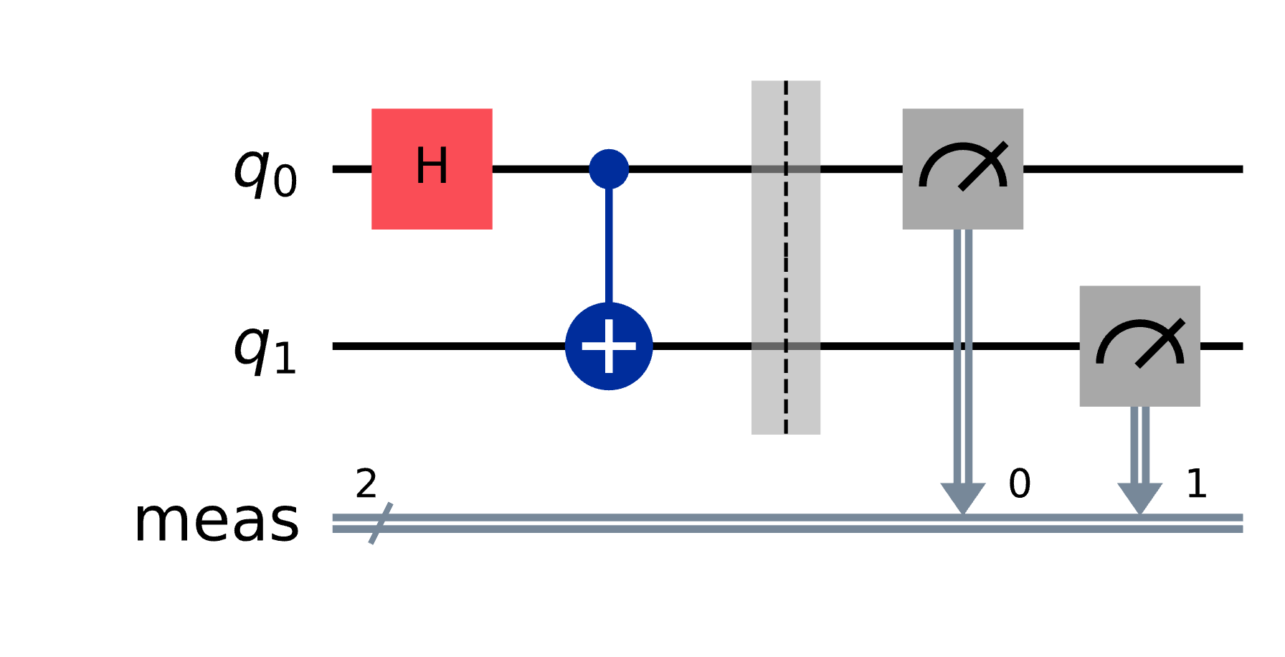
Build a circuit with Qiskit SDK
The foundation of quantum programs are quantum circuits.
They consist of operations—including gates, measurement, and reset—that manipulate qubits.
IBM Quantum | @ 2024 IBM Corporation

Slide 8
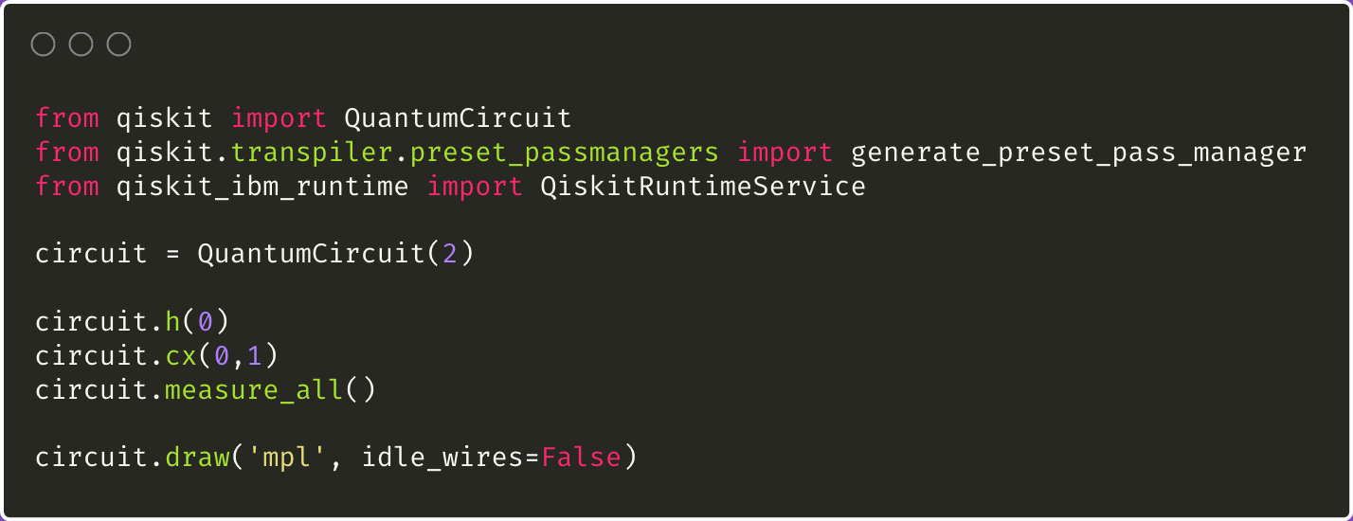
Build a circuit with Qiskit SDK
To build a circuit:
Initialize a register of qubits
Add the qubits to a circuit
Perform operations on those qubits
IBM Quantum | @ 2024 IBM Corporation

Slide 9
Qiskit SDK includes a library of standard gates and circuits.
Standard gates
Hadamard, Pauli rotation gates, CNOT, Quantum Fourier Transform, etc.
Variational ansatzes
Parameterized quantum circuits for chemistry and combinatorial optimization, including hardware efficient ansatzes
IBM Quantum | @ 2024 IBM Corporation
Notes:
Ansatz = prebuilt circuit but you can change the parameters
Also other tools like benchmarking circuits & building your own gates/operators

Slide 10
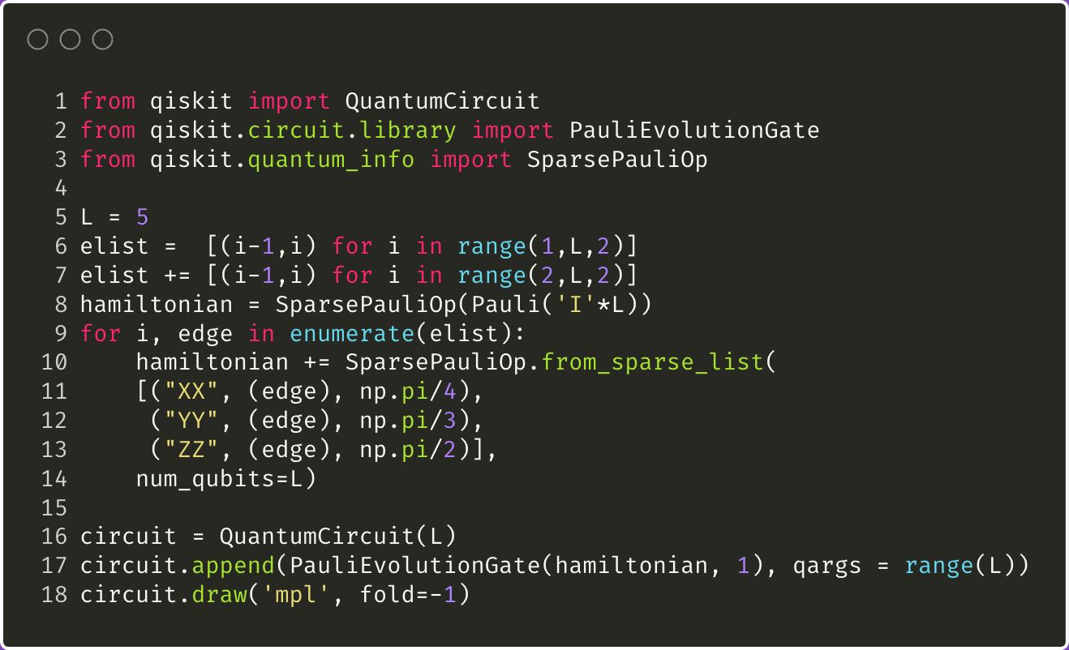
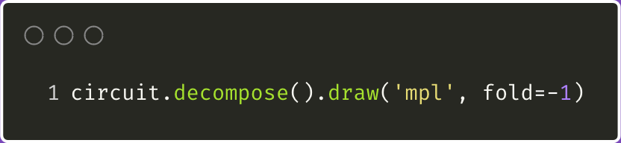
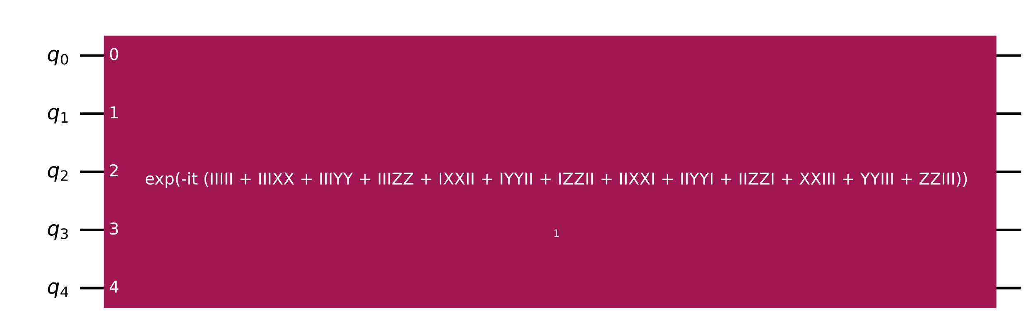
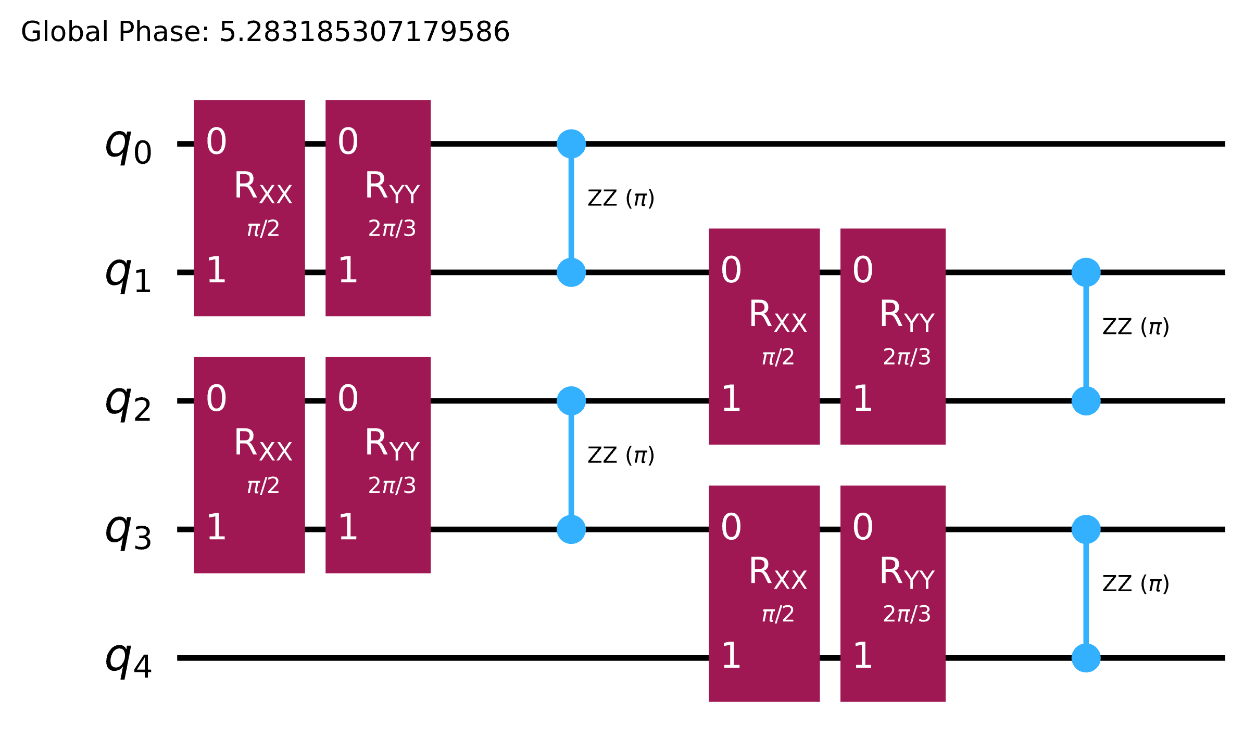
Advanced Circuit Library Tools: PauliEvolutionGate( )

Slide 11
1 Map 2 Optimize 3 Execute 4 Post-process
Transpilation with Qiskit

Slide 12
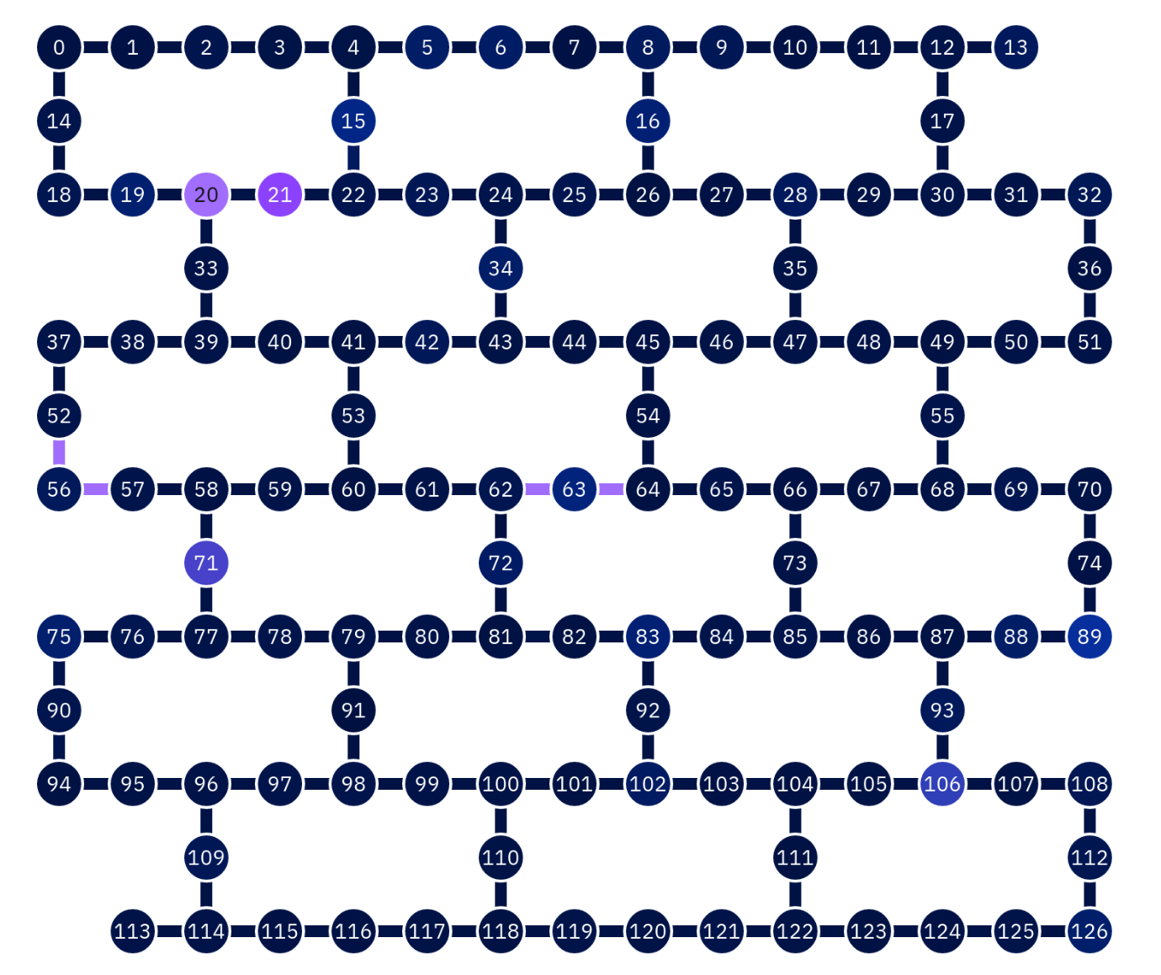
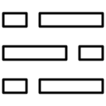

Basis gate set
Only a limited set of gates can be executed directly on the hardware. Other gates must be rewritten in terms of these basis gates.
Qubit connectivity
Only certain pairs of qubits can be directly interacted with each other.
Errors
Each operation has a chance of error, so circuit optimizations can greatly affect performance.
Real quantum devices are subject to constraints
Notes:
Qubit connectivity = ex. Qubit 0 and qubit 7 in a two-qubit gate, but on hardware they are not actually connected to each other. The way that is solved is with inserting swap gates

Slide 13
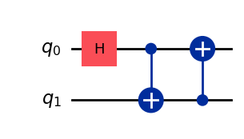
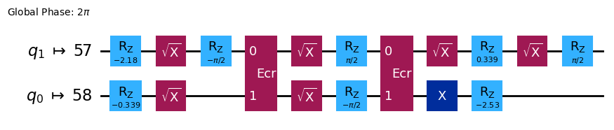
Challenge: run abstract circuit on a specific quantum device.
Solution: transpilation —
convert abstract circuit into an ISA (instruction set architecture) circuit.
Notes:
Inspired by compilation, but not quite the same because you get back a circuit not machine code. Converting to pulse sequences is done with the cloud service
FYI: ECR gate = echo cross resonance, implements C-not

Slide 14
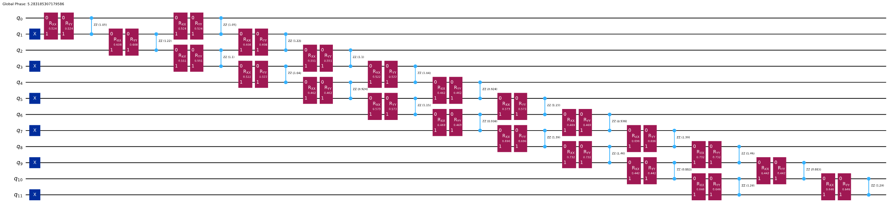
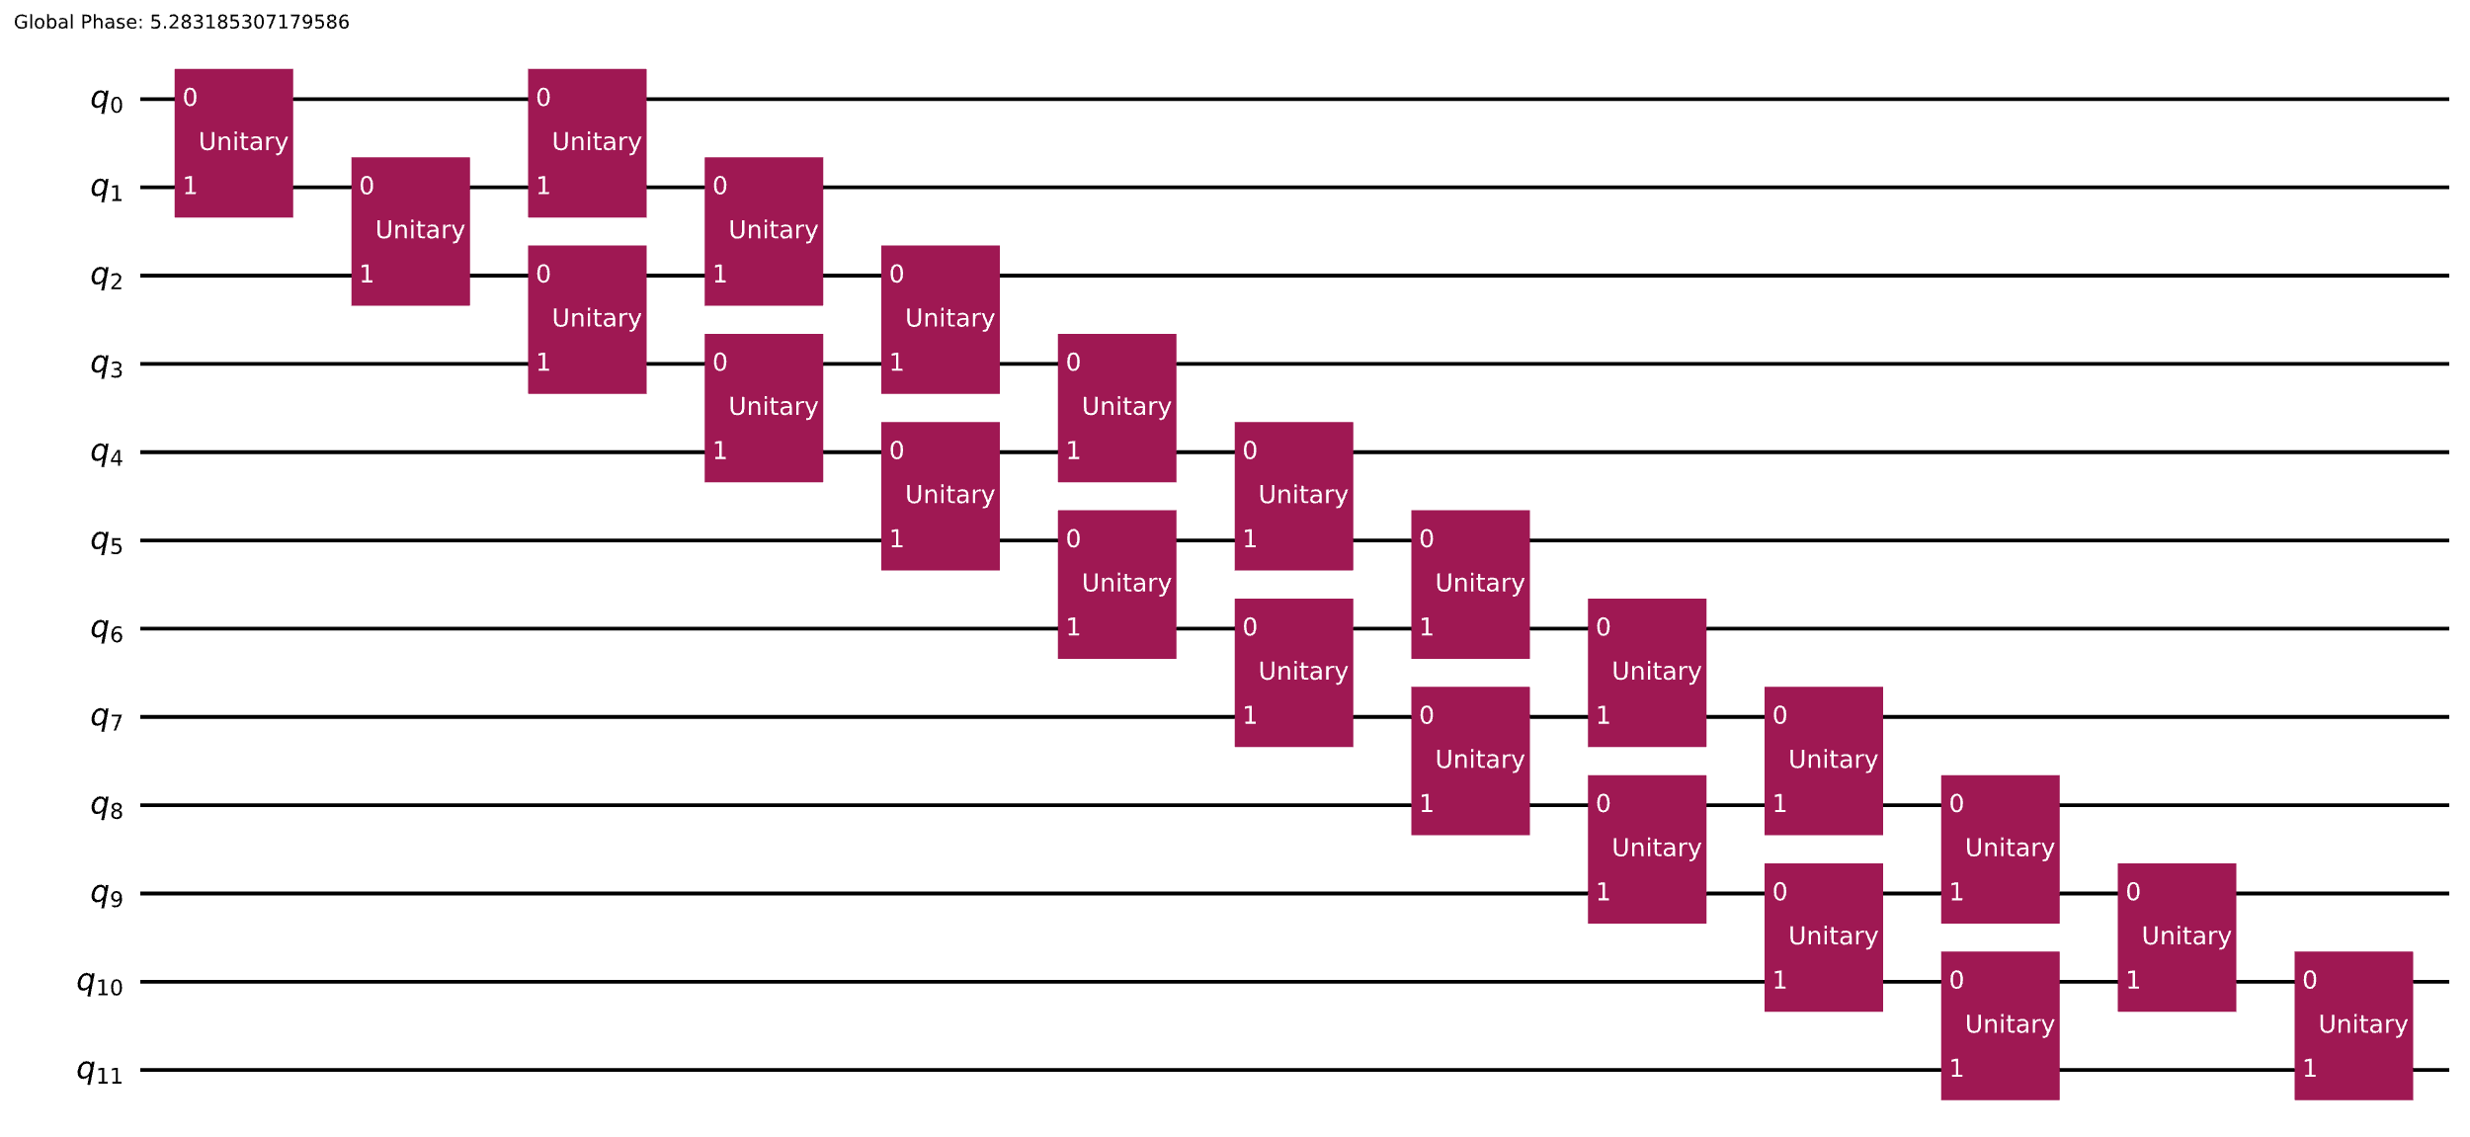
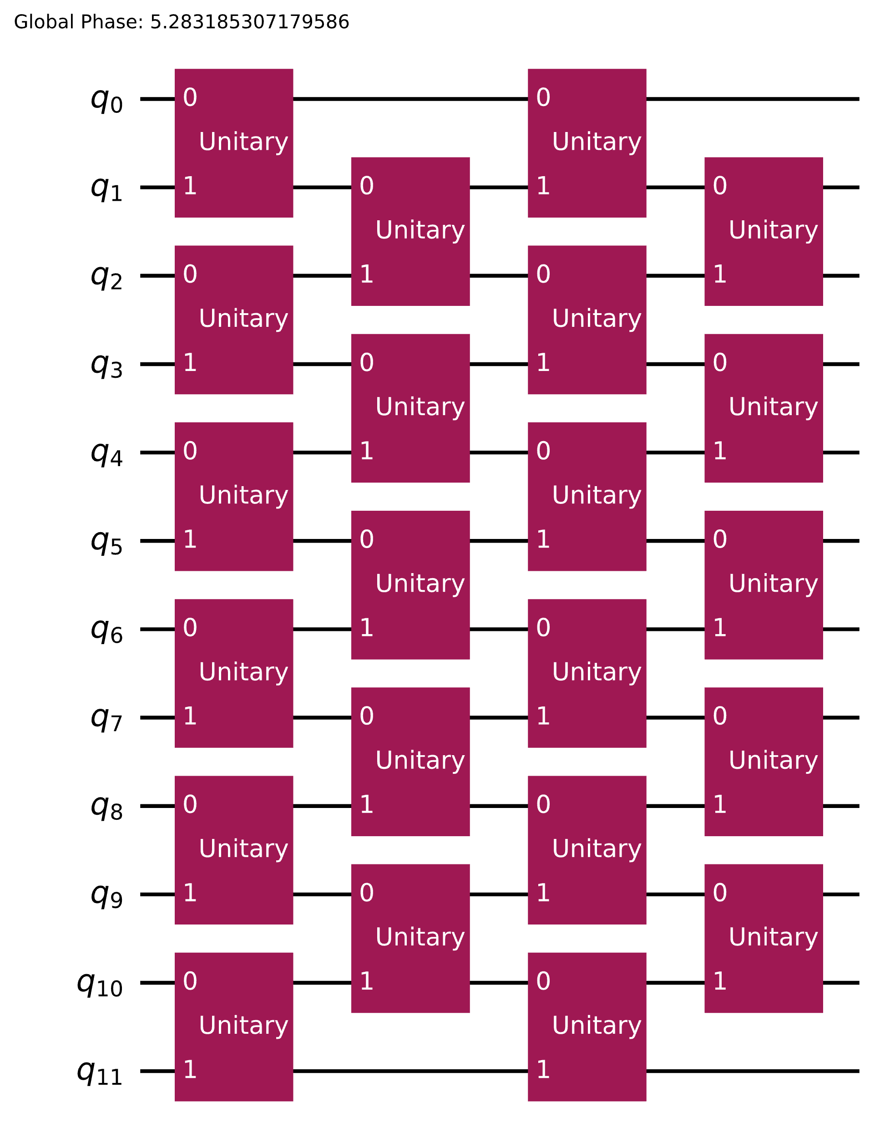
Why do we need quantum circuit transpilation?
Bad transpilation:
2q-depth: 78
Better
2q-depth: 39
Collapse into 2q blocks
Even better
2q-depth: 12
Re-synthesize problem
via Rustiq

Slide 15
Transpiler stages
1. Initialization
The circuit is prepared for transpilation, e.g., multi-qubit gates are decomposed into two-qubit gates.
2. Layout
The abstract qubits of the circuit are mapped to physical qubits on the device.
3. Routing
Swap gates are inserted to enable interactions between qubits that are not physically connected.
4. Translation
The gates of the circuit are translated to the basis gate set of the device.
5. Optimization
The circuit is rewritten to minimize its depth (# of operations) to decrease the effect of errors.
6. Scheduling
Delay instructions are added to align the circuit with the hardware’s timing.
IBM Quantum | @ 2024 IBM Corporation

Slide 16
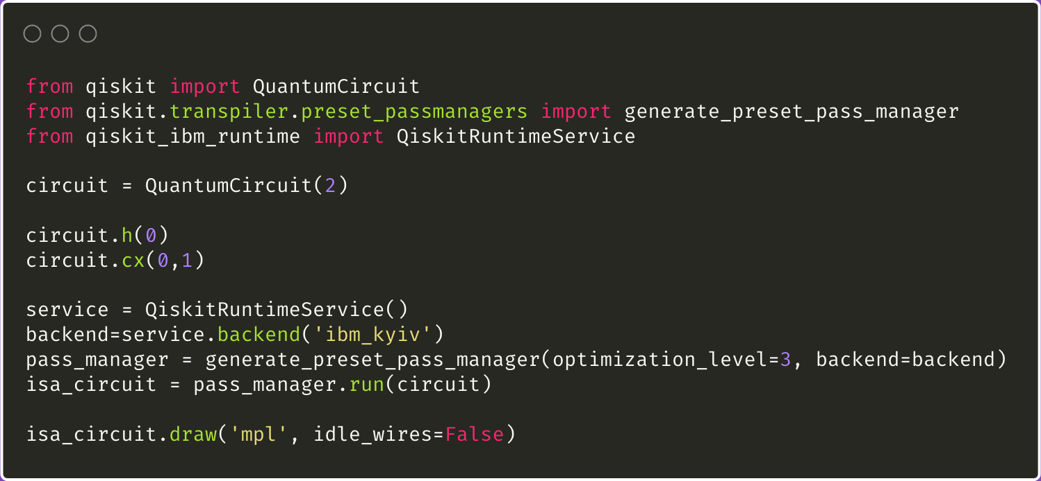
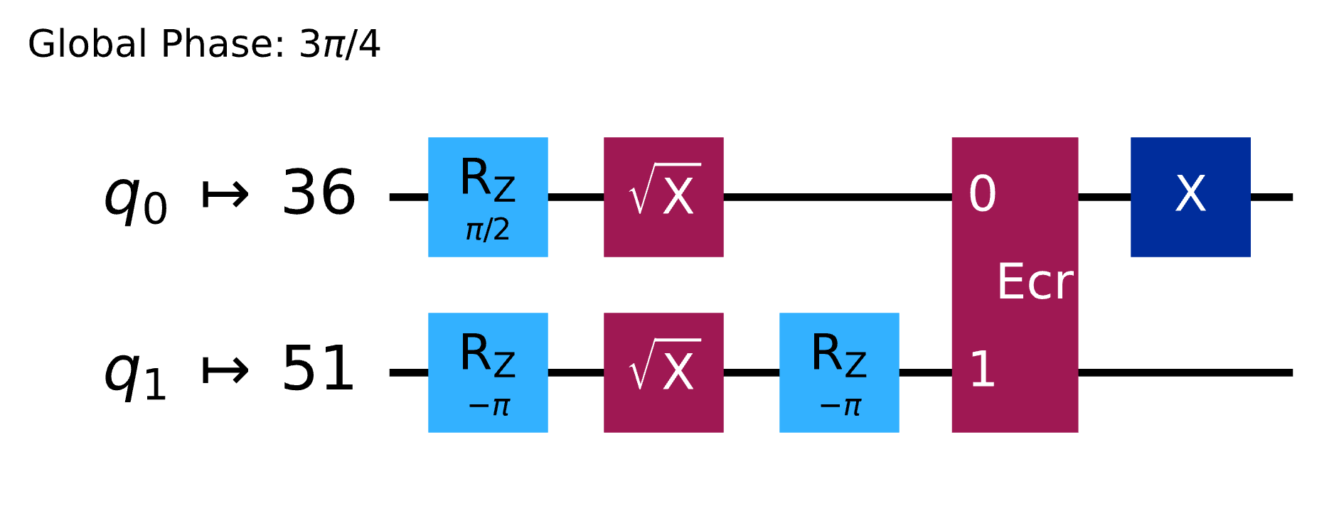
Transpile a circuit with Qiskit SDK
Steps:
Choose which device backend you want to target
Create a preset staged pass manager with your desired optimization level
Run the staged pass manager on the circuit
IBM Quantum | @ 2024 IBM Corporation

Slide 17
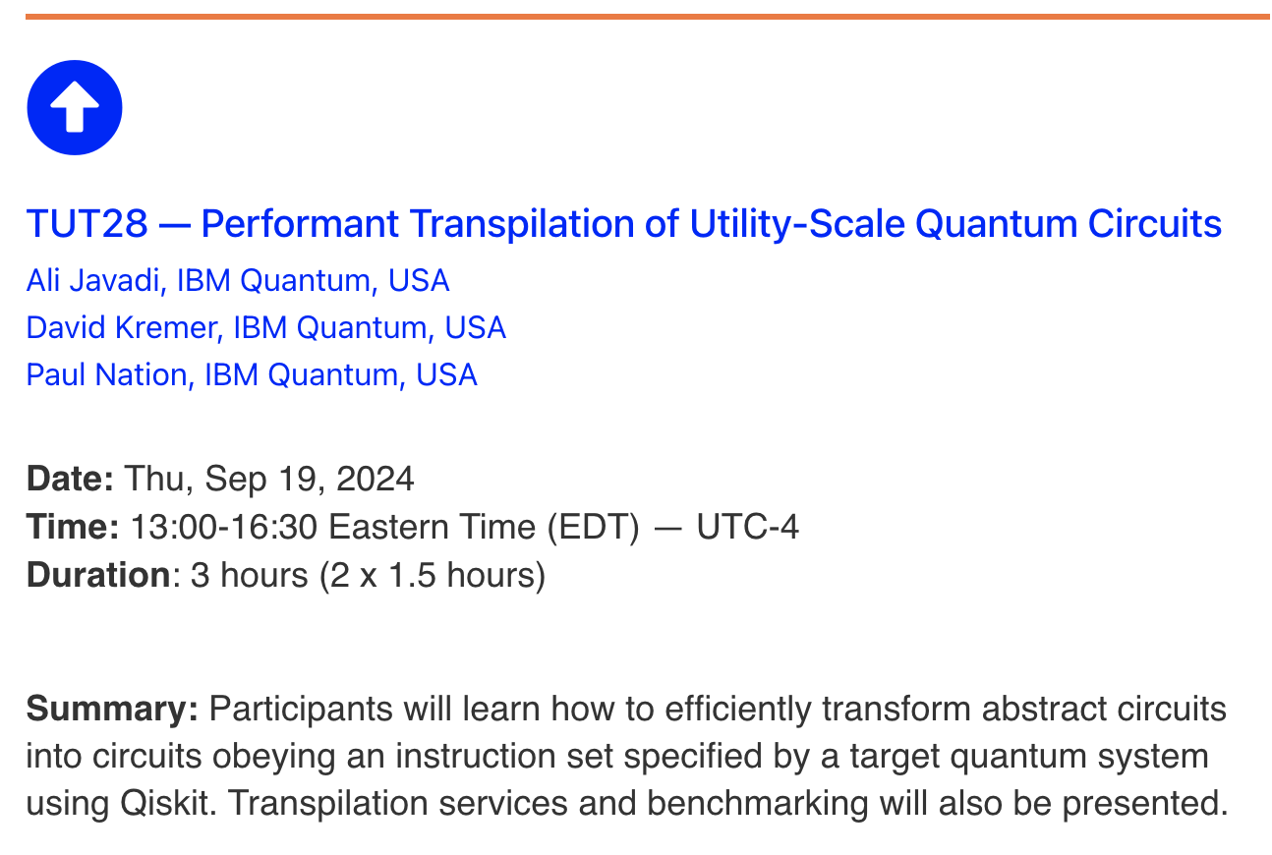
For a deep dive on transpilation with Qiskit, including the AI plugin, check out Tutorial #28 on Thursday!
qce.quantum.ieee.org/2024/program/tutorials-abstracts/#tut28

Slide 18
1 Map 2 Optimize 3 Execute 4 Post-process
Qiskit (Runtime) primitives

Slide 19
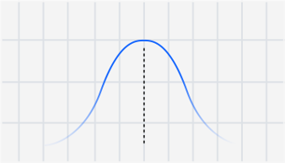
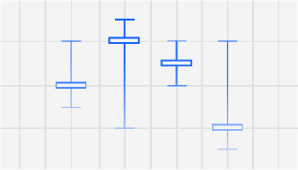
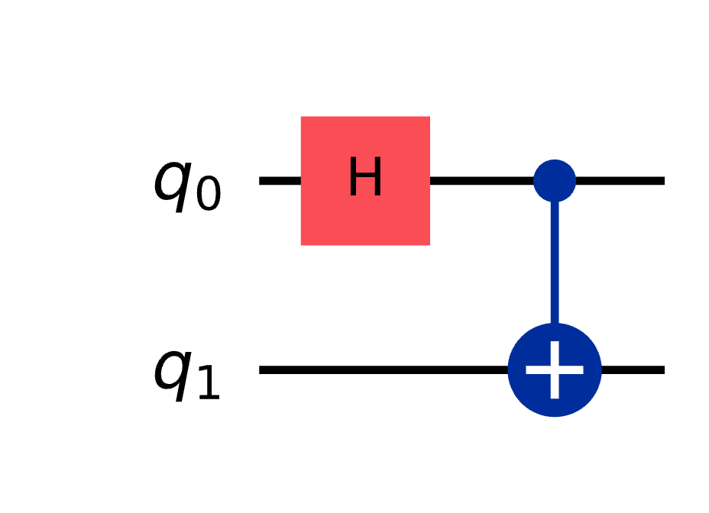
Primitives encapsulate the output of a quantum circuit
Sampler primitive
Estimator primitive
Output is mapping of bitstrings to counts, e.g.,
{'0': 12, '1': 9}
Circuit should include measurements.
Output is the expectation value of an observable, e.g., the net spin of a system.
Circuit should not include measurements.
IBM Quantum | @ 2024 IBM Corporation
Notes:
Expectation value = average value of an observable quantity
Observable = a physical quantity you are measuring, like the Pauli operators to measure the spin of a qubit

Slide 20
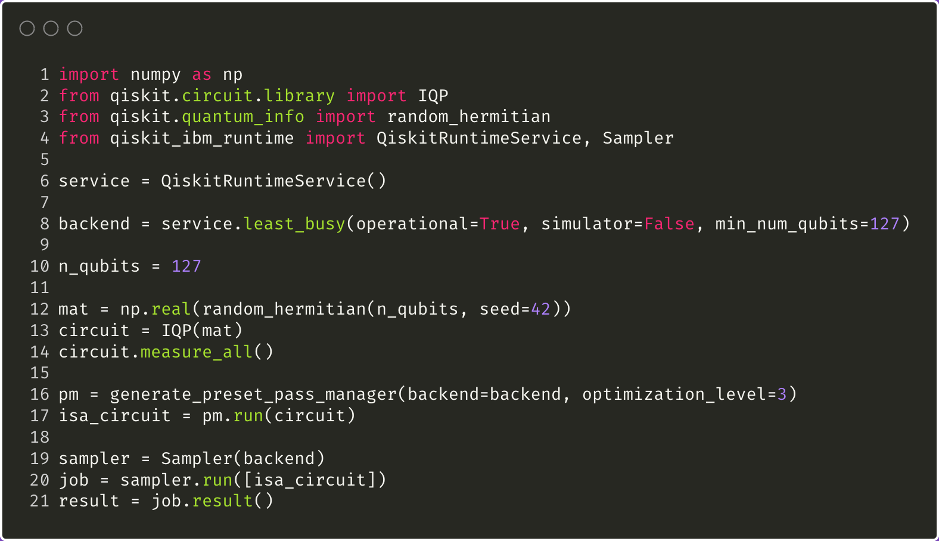
To run a circuit on quantum hardware:
Initialize the Qiskit Runtime service
Choose a hardware backend
Initialize a Qiskit Runtime primitive with your chosen backend
Invoke the primitive with your circuit
IBM Quantum | @ 2024 IBM Corporation
Notes:
IQP = instantaneous quantum polynomial circuit
Has a bunch of T gates, Hadamard gates etc

Slide 21
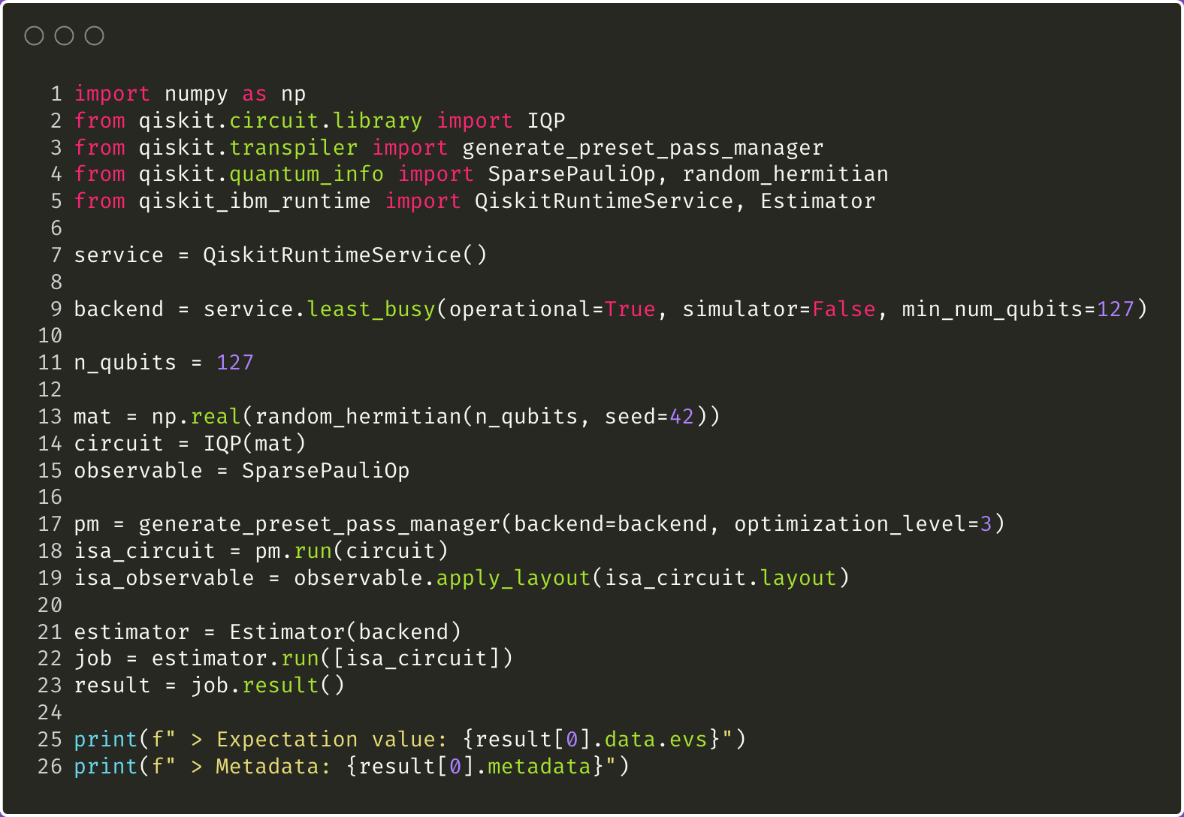
The input to the Estimator primitive is a list of primitive unified blocs (PUBs). Each PUB consists of:
A single circuit without measurements
One or more observables
(Optional) One or more parameter values
IBM Quantum | @ 2024 IBM Corporation
Notes:
Line 15 is an example observable: measure spin in the z-axis
Mention Sampler can also take input as a PUB if e.g. have a list of parameters

Slide 22
Shots
The number of measurements.
More shots reduce statistical error but increase running time.
Error suppression
Use dynamical decoupling to reduce decoherence during execution.
Caveat: requires delays between gate executions, so it’s not always possible.
Error mitigation
Reduce the effects of device noise after execution.
Twirled Readout Error eXtinction (TREX) measurement twirling
Zero Noise Extrapolation (ZNE)
Downside: computational overhead
You can customize Qiskit Runtime behavior
Notes:
Dynamical decoupling = inserts specific set of pulse sequences to reduce decoherence.

Slide 23
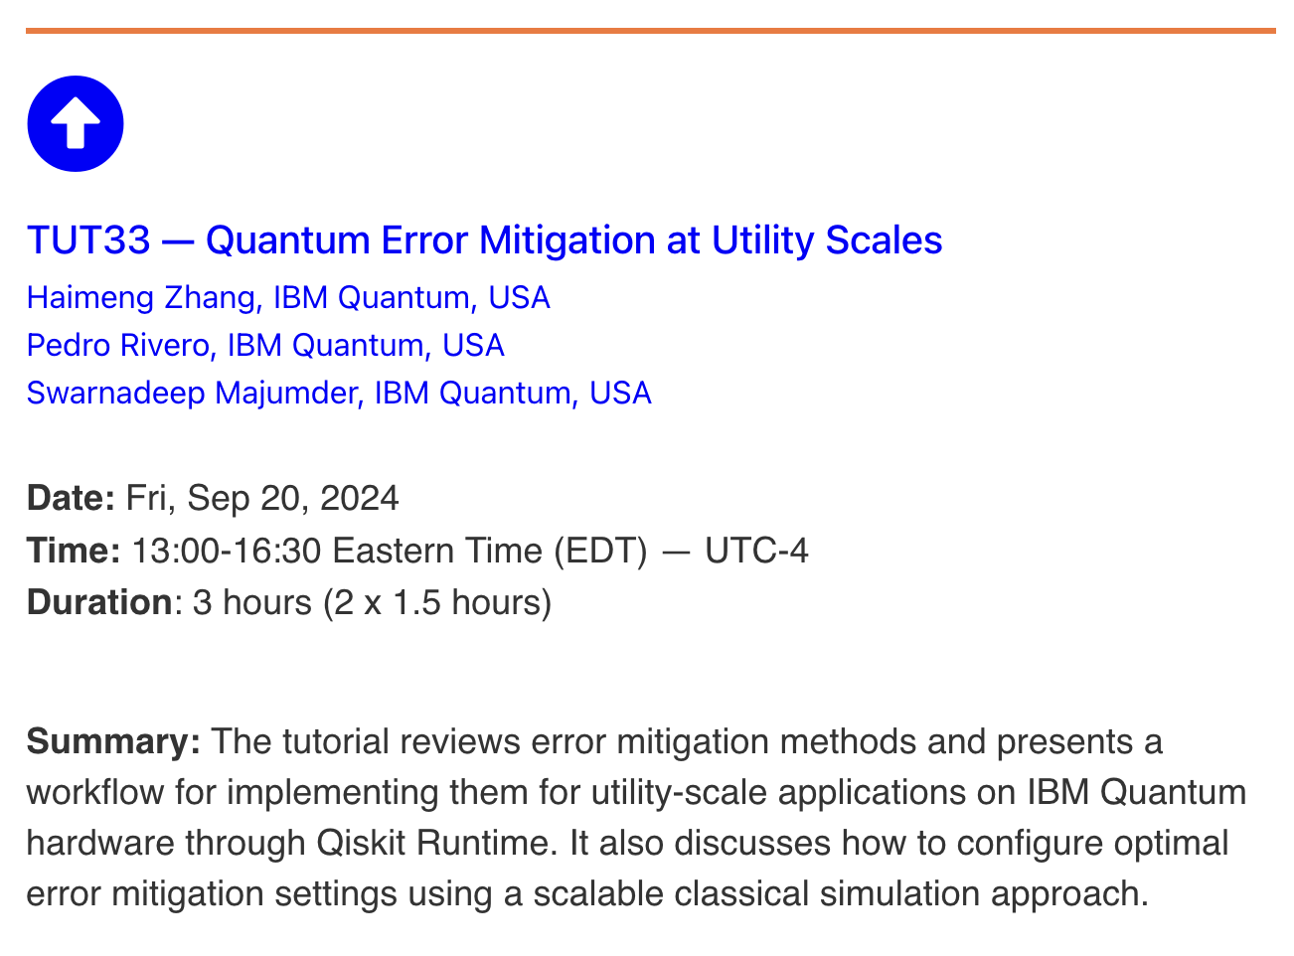
For a deep dive on error mitigation with Qiskit, check out Tutorial #33 on Thursday!
qce.quantum.ieee.org/2024/program/tutorials-abstracts/#tut33

Slide 24
Coding example: Hamiltonian simulation workflow with Qiskit

Slide 25
Part 2 Enabling algorithm discovery with Qiskit addons

Slide 26
Qiskit SDK sets the foundation
Qiskit SDK gives us a base layer of building blocks for building and running quantum algorithms
Qiskit Circuit Library
Transpiler
Primitives
Quantum Info
Input: Domain inputs
Input: Circuits, observable
Input: ISA circuit, observable
Input: Expectation value/samples
Output: Circuits, observable
Output: ISA circuit, observable
Output: Expectation value/samples
Output: Data objects/visualizations
Map
Optimize
Execute
Post-process
Notes:
Qiskit SDK sets the foundation for building using this pattern.

Slide 27
Introducing Qiskit addons
A collection of research capabilities developed as modular tools that can plug into a workflow to scale or design new algorithms at the utility scale—starting with multiproduct formulas (MPF), operator backpropagation (OBP), and sampling-based quantum diagonalization (SQD).
MPF
OBP
SQD
Qiskit Circuit Library
Transpiler
Primitives
Quantum Info
Input: Domain inputs
Input: Circuits, observable
Input: ISA circuit, observable
Input: Expectation value/samples
Output: Circuits, observable
Output: ISA circuit, observable
Output: Expectation value/samples
Output: data objects/visualizations
Map
Optimize
Execute
Post-process
Notes:
Qiskit add-ons level it up.
A collection of research capabilities developed as modular tools that can plug into a workflow to scale or design new algorithms at the utility scale.

Slide 28

For more information about Qiskit addons and how to access them, check out the IBM Quantum Documentation

Slide 29



1 Map 2 Optimize 3 Execute 4 Post-process
Qiskit addon for multi-product formulas
Qiskit/qiskit-addon-mpf
Niall Robertson
Max Rossmannek
Kate Marshall

Slide 30
Multi-product formulas (MPF)
domain inputs
Map
MPF - preprocess
A quantum computer can only approximate the exact time evolution of a Hamiltonian due to algorithmic errors known as Trotter errors.
Multi-product formulas (MPF) are a technique to reduce this error through a weighted combination of several circuit executions.
Computational tradeoffs/scaling: Generate a small set of circuits with increasing numbers of Trotter steps and extrapolate towards the exact limit. For a given set of Trotter steps, this extrapolation is cheap, but finding a good set of values may be difficult.
Problem domains: Applicable to any use case involving Trotter formulas.
many circuits, observable
Optimize
Transpile circuit
many ISA circuits, observable
Execute
Estimator Primitive
expectation values
Postprocess
MPF - postprocess
expectation value
arXiv:2407.17405, arXiv:2306.12569, arXiv:2207.11268 (Quantum 7, 1067 (2023))

Slide 31
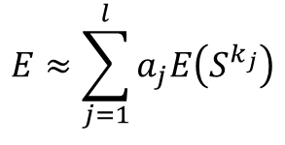


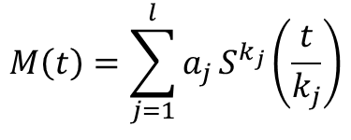
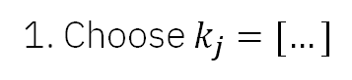


Multi-product formulas (MPF)
$$M\left(t\right)=\sum_{j=1}^{l}{a_{j}}S^{k_{j}}\left(\frac{t}{k_{j}}\right)$$
1. Choose $k_{j}=[…]$
2. Compute $a_{j}=[…]$
$$E≈\sum_{j=1}^{l}{a_{j}E\left(S^{k_{j}}\right)}$$
Replace single PF with MPF
$$S^{k_{1}}$$
$$S^{k_{2}}$$
$$S^{k_{3}}$$

Slide 32
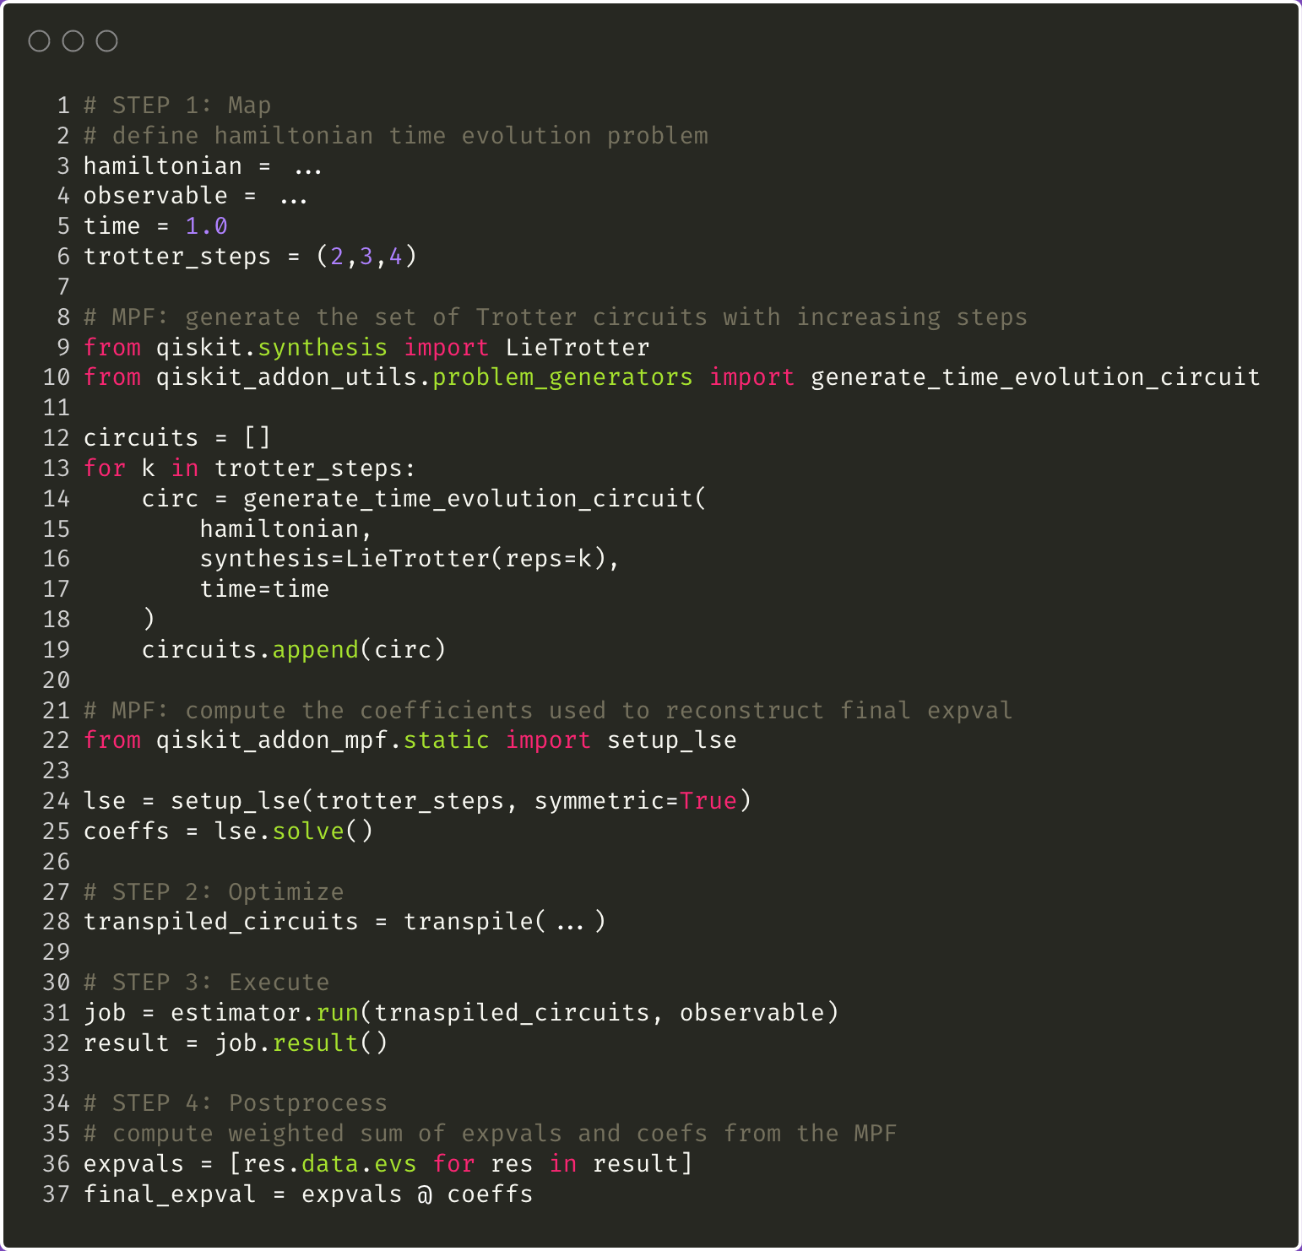
Pseudocode: basic usage of MPF in a Qiskit pattern

Slide 33


1 Map 2 Optimize 3 Execute 4 Post-process
Qiskit addon for operator back-propagation
Qiskit/qiskit-addon-obp
Minh Tran
Max Rossmannek
Caleb Johson

Slide 34
Operator backpropagation (OBP)
domain inputs
Map
Create circuit, observable
Experimental errors limit the depth of quantum circuits that can be executed on near-term devices.
OBP reduces circuit depth by trimming operations from its end at the cost of more operator measurements.
Computational tradeoffs: The number of quantum circuits grows exponentially with number of non-Clifford gates which are backpropagated
Problem domains: Applicable to expectation value estimation. Is well-suited to Hamiltonian simulation.
circuit, observable
OBP
Optimize
shorter circuit, expanded observable
Transpile circuit
shorter ISA circuit, expanded observable
Execute
Estimator Primitive
expectation value
Postprocess
postprocess
domain outputs

Slide 35
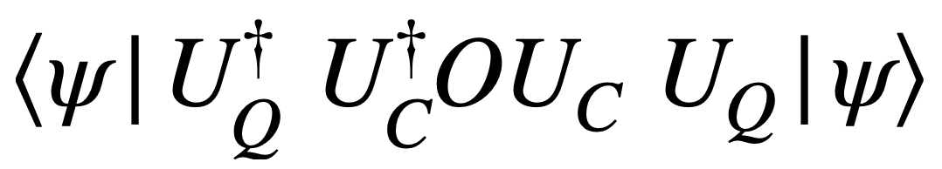
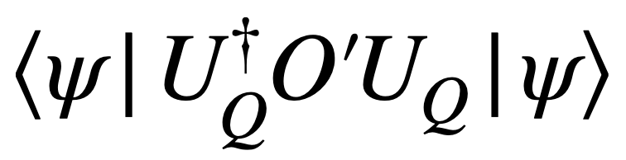
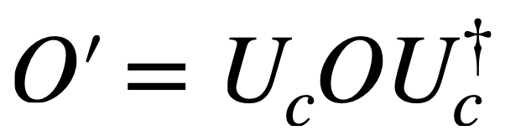
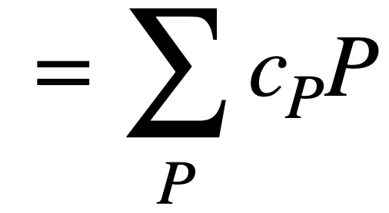

Operator backpropagation (OBP)
$$O$$
U_{Q}
U_{C}
Classically absorb U_{C} into O
U_{Q}

Slide 36
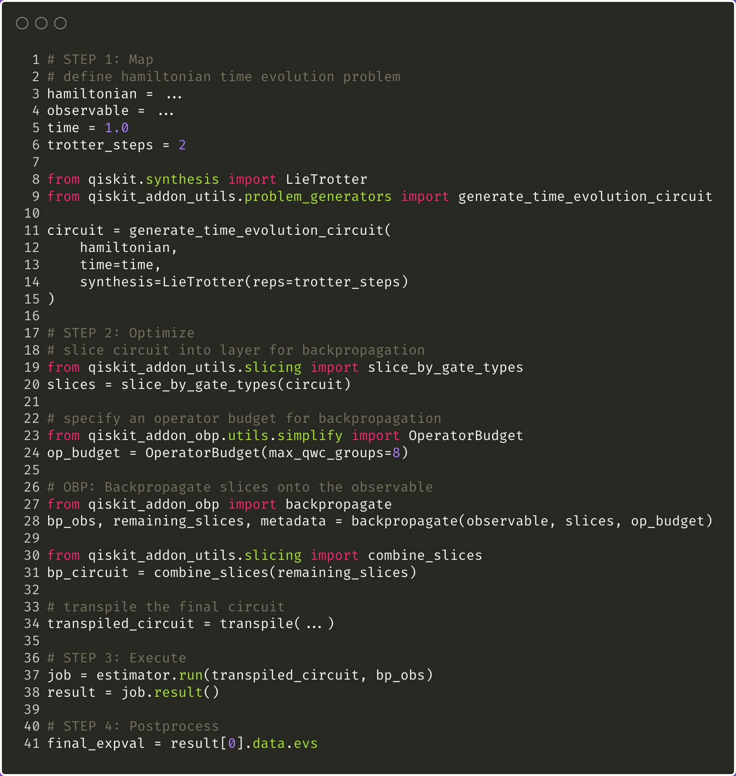
Pseudocode: basic usage of OBP in a Qiskit pattern

Slide 37
Coding example: Hamiltonian simulation workflow augmented with Qiskit addons

Slide 38
Part 3 Eigenvalue estimation of chemistry Hamiltonians with SQD Qiskit addon

Slide 39

1 Map 2 Optimize 3 Execute 4 Post-process
Qiskit addon for sample-based quantum diagonalization
Qiskit/qiskit-addon-sqd
Javier Robledo Moreno
Caleb Johson

Slide 40
Sample-based Quantum Diagonalization (SQD)
domain inputs
Map
Create circuit, observable
circuits
Finding the lowest eigenvalues of complex system Hamiltonians requires deep circuits and many measurements.
SQD is a technique leveraging quantum and distributed classical computing together to estimate these eigenvalues for scales beyond the reach of exact classical diagonalization.
Computational tradeoffs: The dimension of the subspace needed to accurately describe the ground state grows exponentially with system size.
Problem domains: Electronic structure problems or general quantum simulation problems.
Transpile circuit
Optimize
ISA circuit, observable
Execute
Sampler
samples
Postprocess
SQD
energy estimation
arXiv:2405.05068

Slide 41
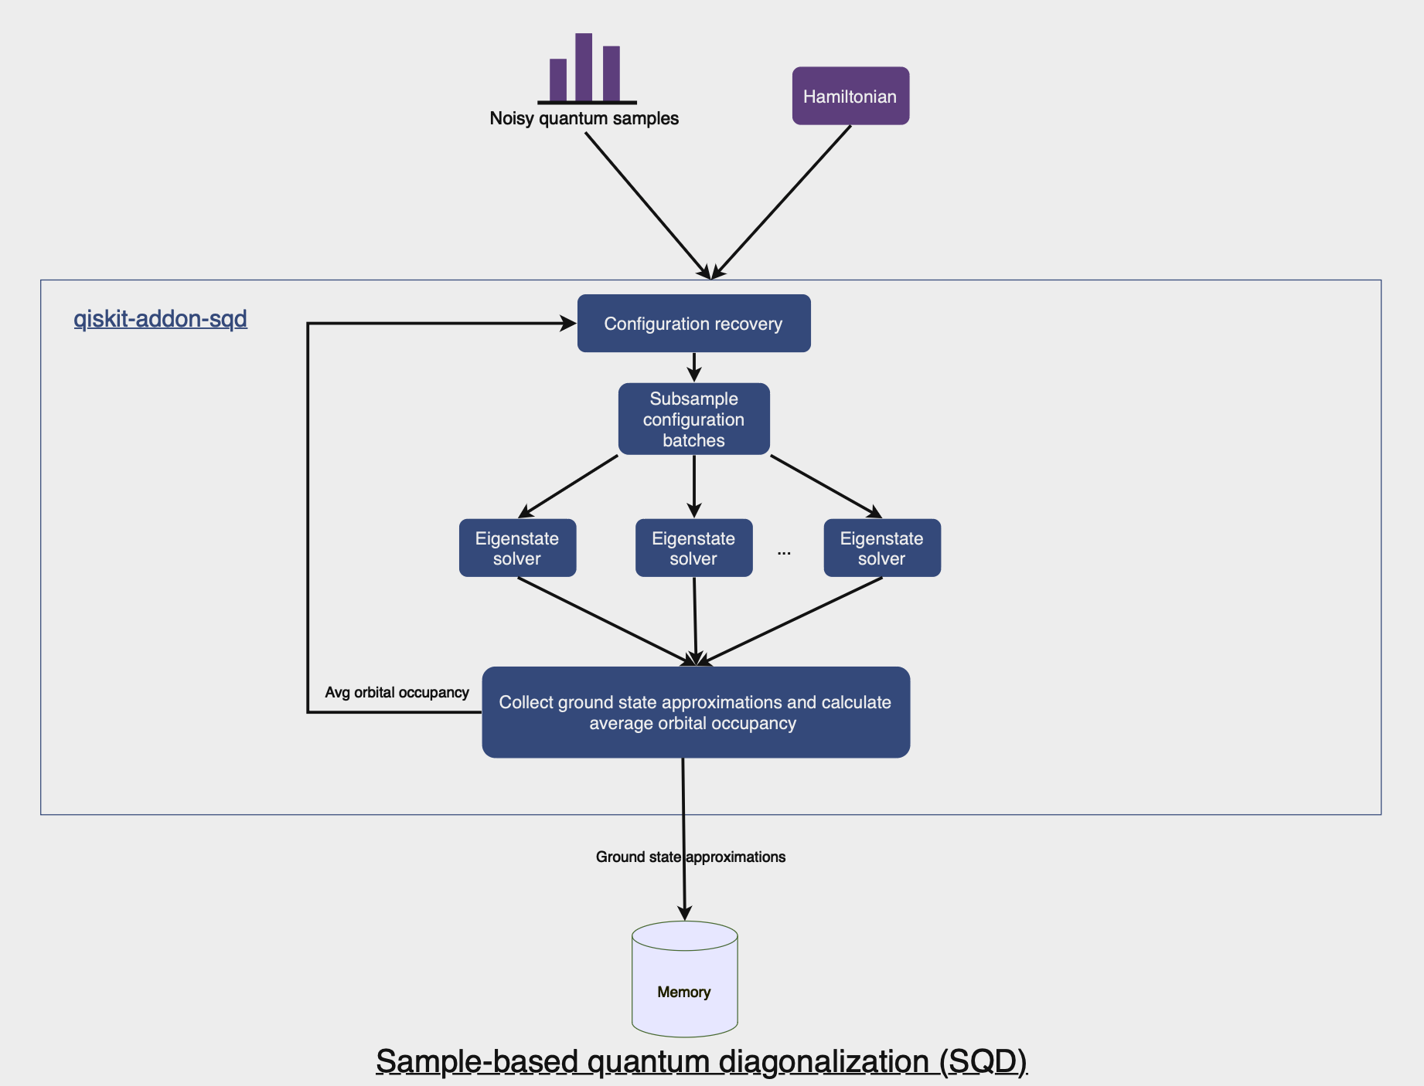
Sample-based Quantum Diagonalization (SQD)

Slide 42
Coding example: Chemistry ground state workflow augmented with Qiskit addons

